Slide 1
CS6461 – Computer Architecture
Fall 2021
Morris Lancaster - Lecturer
Adapted from Professor Stephen Kaisler’s Notes
Lecture 10
High Performance Computing: Multiprocessors
Notes:
Thus far, we have been looking at computer architecture primarily from a single-processor perspective.
In this lecture, we shift our focus to multiprocessors as a model for high-performance computing.
We will examine how multiple processors interact, including their information flows and operational behavior, and we will also discuss the limitations that arise in these systems.

Slide 2
Introduction
So far, we have studied uniprocessors – one processor, possibly pipelined, and one memory - and vector processors, still one computer with special functional units.
Performance can be improved through the use of multiple processors. Multiprocessors allow multiprogramming, e.g., true concurrent or parallel programming.
Idea: create powerful computers by connecting many smaller ones
good news: works for timesharing (better than supercomputer)
bad news: it’s really hard to write good concurrent programs; many commercial failures
Ref: Introduction to Parallel Processing: Algorithms and Processing, by Behrooz Parhami
Notes:
Up to this point, we have focused on single-processor systems, even when pipelined or vectorized. The key limitation in those systems is that execution is fundamentally constrained by a single control flow.
Now we shift to multiprocessors, where multiple processors can execute simultaneously. The idea is not just to make one processor faster, but to coordinate many processors working together to improve overall performance. This introduces both opportunities and significant challenges, particularly in how we design and manage parallel execution.
There are two primary categories of applications for multiprocessors.
The first is similar to time-sharing systems or web servers, where multiple processes execute independently with little or no interaction between them. In this case, the goal is throughput—handling many separate tasks efficiently.
The second category involves multiple processors or functional units working together on the same problem. Here, dependencies exist between operations, and the order and timing of execution become critical. This is where true parallel computing occurs, and where coordination and synchronization become major challenges.

Slide 3
Paradigms
Parallel Computing
Simultaneous use of multiple processors - all components of a single architecture - to solve a task. Typically processors identical, single user (even if machine is multi-user).
Distributed Computing
Use of a network of processors, each capable of being viewed as a computer in its own right, to solve a problem. Processors may be heterogeneous, multi-user, and usually individual tasks are assigned to individual processors.
Concurrent Computing
Both of the above
Notes:
Now that we’ve introduced multiprocessors, we need to clarify how they are actually used. There are three related but distinct paradigms: parallel computing, distributed computing, and concurrent computing.
Parallel computing refers to multiple processors working together within a single system to solve one problem. Typically, these processors are tightly coupled, may share memory, and are coordinated as part of one architecture. This is what we usually mean when we talk about high-performance computing.
Distributed computing, on the other hand, involves multiple independent computers connected by a network. Each system can operate on its own, and tasks are divided across them. These systems may be heterogeneous and are often designed for scalability and fault tolerance rather than tight coordination.
Concurrent computing is the broader concept that includes both. It simply means that multiple computations are happening during overlapping time periods, whether they are tightly coupled or completely independent.
The key distinction to keep in mind is this: parallel computing is about solving one problem faster using multiple processors, while distributed computing is often about solving many problems or scaling across systems. This distinction will become important when we discuss memory models and communication overhead.

Slide 4
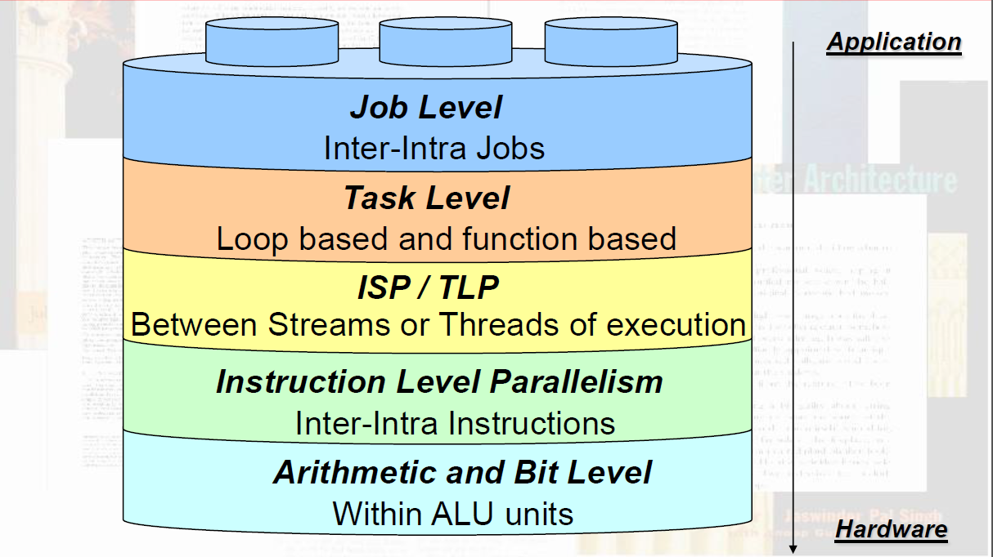
Types of Parallelism
Notes:
Parallelism exists at multiple levels within multiple computer systems or system components, and it is important to understand how these levels build on each other.
At the lowest level, we have parallelism within functional units. This occurs inside the processor itself, particularly in arithmetic and logic units. For example, modern arithmetic units may use techniques such as pipelining or parallel carry computation to perform operations like addition or multiplication more efficiently. Even within a single instruction, multiple hardware elements may be working simultaneously to produce a result.
The next level is instruction-level parallelism, or ILP, which we have been focusing on up to this point. This involves executing multiple instructions from a single program at the same time. Techniques such as pipelining, superscalar execution, and out-of-order execution allow different stages of multiple instructions to overlap in time. The key idea is that even within a single thread of execution, we can exploit concurrency.
Above that is instruction stream parallelism, often referred to as thread-level parallelism. Here, we are executing multiple independent streams of instructions concurrently. A good example is a dynamic web application, where one thread may handle user interaction, another updates the web page, and another performs data processing in response to user actions. These instruction streams are independent but may interact through shared data.
Moving up, we have task-level parallelism, where separate functional components of a system operate concurrently. These tasks may not be directly triggered by user actions. For example, in a web system, a background task might update cached data or trigger system events. In a more embedded or real-time system, such as a ship’s navigation system, sensor updates may trigger a separate task that processes data and updates a display independently of user input.
At the highest level, we have job-level parallelism, which is the most coarse-grained form. Here, entirely separate jobs or programs are executed concurrently, often in the background. These jobs may have no interaction with each other and are typically scheduled by the operating system to maximize system utilization. Examples include batch processing, background analytics, or maintenance tasks running alongside interactive applications.
The key takeaway is that parallelism is not a single concept—it exists across multiple layers, from hardware circuits all the way up to independent jobs. As we move up these levels, the granularity increases, coordination becomes more complex, and the role of the operating system and software becomes more significant.
A question to consider: which level of parallelism gives us the greatest performance improvement, and which level is the most difficult to design and manage?

Slide 5
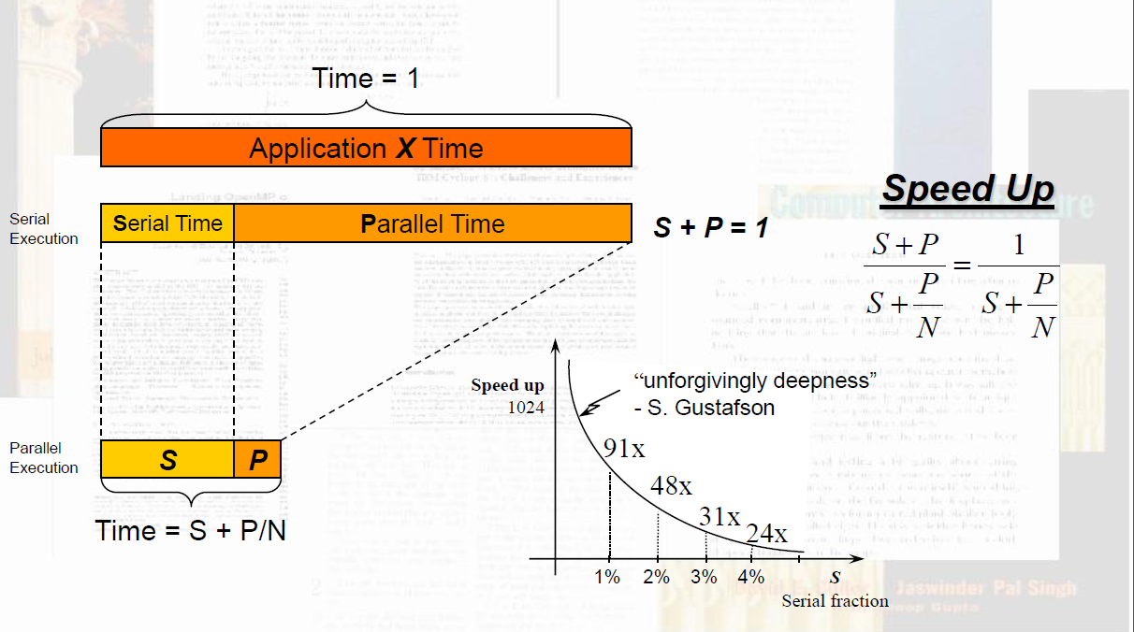
For A Given Problem
Notes:
This slide introduces Amdahl’s Law, and the key objective here is to understand the limitations imposed by portions of a program that must be executed in order.
We have previously discussed out-of-order execution and dynamic scheduling. Even in those cases, there were segments of code that had to be executed sequentially due to data dependencies or control constraints.
That same idea applies here, but now at a larger scale. Instead of looking within a single processor, we are considering execution across multiple functional units, which may reside on the same chip or even be distributed across physically separate systems.
The key point is that any portion of the computation that must be done sequentially will limit the overall speedup, regardless of how many processors we add.
Speedup is defined as the total execution time of the program when done sequentially, divided by the time required when executed in parallel. This parallel time consists of the sequential portion plus the parallel portion divided among the available processors.
In other words, even if we increase the number of processors, the sequential portion remains unchanged, and it becomes the limiting factor in overall performance improvement.

Slide 6
Speedup
If we can do some computations in parallel, then we can attain a speedup over sequential execution:
Speedup = T_{sequential}/T_{parallel}
Amdahl (Gene) defined the speedup for a parallel processor as:
S = 1/(f + (1-f)/p)
where: p = # processors; f = fraction of unparallelizable code
So, if f = 10%, the speedup can be no greater than 10!
  With p = 10, S = 1/(0.1 + 0.9/10) ~= 5.3
  With p = infinity, S = 1/(0.1 + 0.9/infinity) = 10
Notes:
To repeat key points:
Speedup measures how much faster a parallel system performs compared to a sequential one.
Amdahl’s Law tells us that the serial portion of a program limits overall speedup. Even if we had an infinite number of processors, we cannot eliminate the portion of the code that must be executed sequentially.
For example, if 10 percent of the code must be executed in order, then the maximum possible speedup is 10, regardless of how many processors we use.
This highlights a critical design insight: adding more processors does not necessarily lead to proportional performance gains.
Therefore, optimization efforts should focus not only on increasing parallelism, but also on reducing the sequential portion of the program.
.

Slide 7
Efficiency
Efficiency is the ratio of speedup to p: 5.3/10 ~= 53%
  Ignores the possibility of new algorithms, with much smaller f
  Ignores possibility that more of a program is run from higher speed memory, such as registers, cache, main memory
  often, problem is scaled with the number of processors
  f is a function of size of the program which may be decreasing
  serial code may take constant time, independent of size (George Michael – 80/20 vs 20/80 rule)
Notes:
Efficiency is the ratio of speedup to number of processors. It reflects how effectively processors are utilized. As processors increase, efficiency typically decreases due to overhead and sequential constraints.

Slide 8
Multiprocessor Example
Compare performance of a single Motorola 68020 with ten 68020’s coupled as a multiprocessor
Consider the task of adding 100 numbers in memory
The ADD.W <ea>,Dn op takes 4 clock cycles. Thus, a single 68020 would take 400 clock cycles to add 100 numbers one at a time
Multiprocessor works as follows:
a. All 10 uPs would add first 10 numbers each = 40 cycles
b. 5 uPs would add 10 partial sums = 4 cycles
c. 2 uPs would 4 of 5 partial sums = 4 cycles
d. one uP would add three partial sums of two = 8 cycles
Total: 56 cycles!
Performance Improvement: 7.14 (not 10 due to overhead)
Notes:
Multiprocessor examples illustrate how systems achieve parallelism through coordination of multiple processing elements. These demonstrate real-world tradeoffs between performance and complexity.

Slide 9
Limitations
Software Inertia: Billions of dollars worth of FORTRAN and C/C++ and COBOL software exists.
  Who will rewrite them?
  Into what programming language?
Many programmers have experience with multicore computers, but – to the extent they program – they have no direct experience.
  Who will retrain them ?
What about languages which are becoming obsolete: Tcl, other scripting languages, etc.
Notes:
When we talk about limitations, it is useful to think in terms of two forms of inertia that slow the adoption of parallel computing.
The first is application inertia. There are billions of dollars invested in existing software systems written in languages and designs that do not naturally support parallelism. Rewriting these systems is costly, risky, and often unnecessary from a business perspective. As a result, many systems continue to operate in largely sequential models.
The second is personnel or programmer inertia. Many developers simply have not had the opportunity to gain deep experience with parallel programming models. This is not a failure on the part of programmers—it reflects the historical reality that most computing problems could be solved effectively without parallel approaches.
In fact, we have already addressed many of the problems that are relatively straightforward to parallelize. What remains are significantly more complex problems, where dependencies, synchronization, and communication make parallel solutions much more difficult to design and implement.
Additionally, many business applications do not require this level of complexity, or organizations do not have the time or resources to dedicate senior computer scientists to redesign systems for parallel execution.
And this is where you come in. As graduate students, you are being trained to think at this level—to take on the more difficult problems, to understand these constraints, and to develop new approaches that can effectively leverage parallelism where it truly matters.

Slide 10
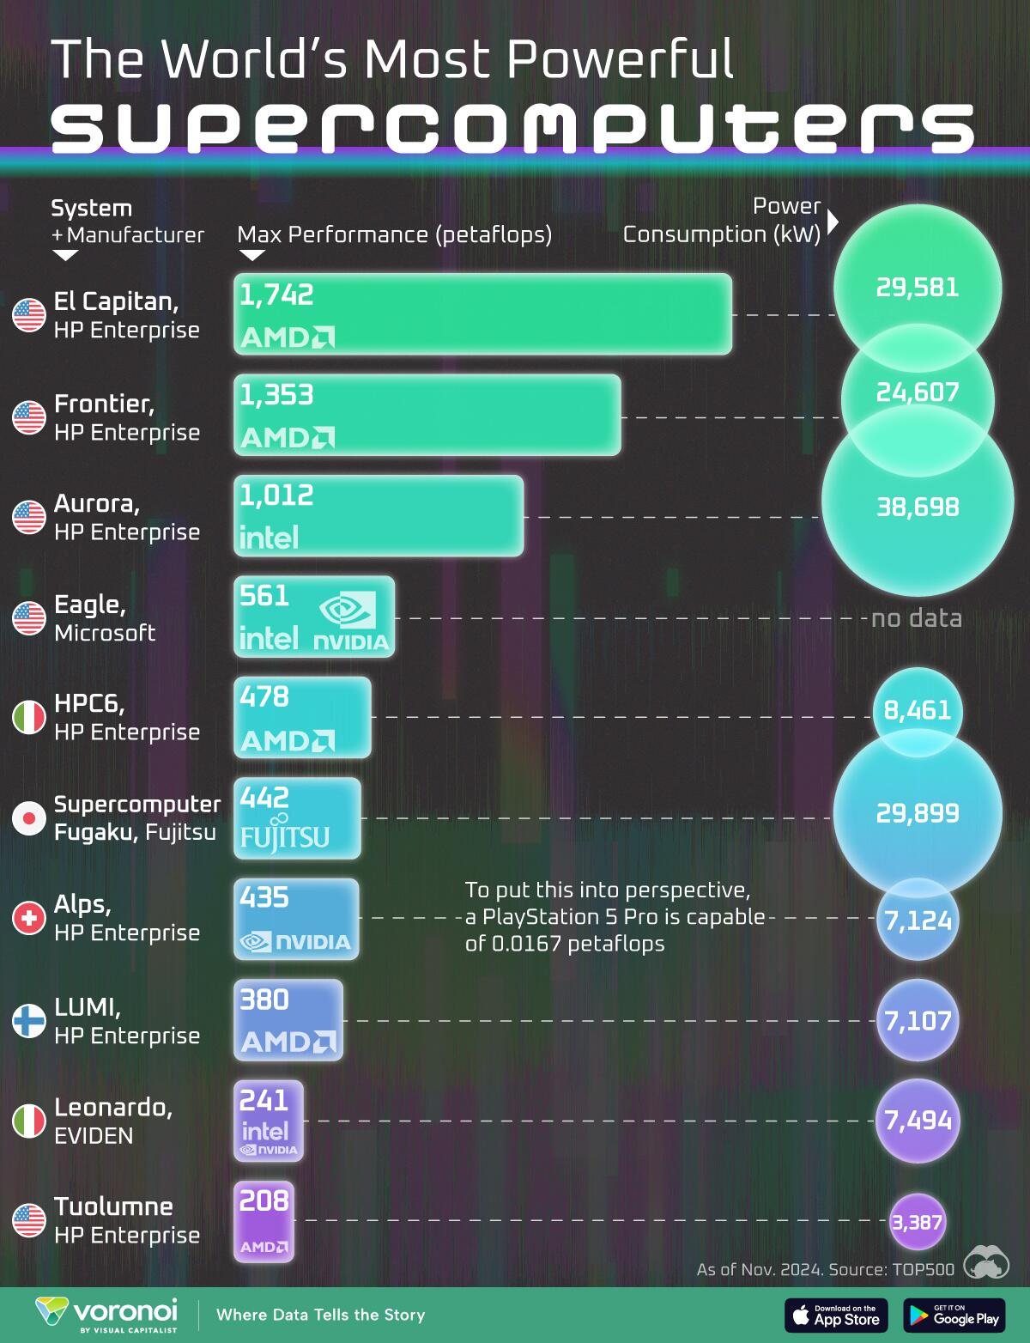
The Path to PetaFLOPS
Notes:
This figure represents a historical snapshot of the machines that were the fastest computers at various points in time. It is essentially a prior version of the evolving list of top-performing systems.
What you should observe is the trend: as we approach physical limitations in shrinking computing elements, performance improvements are no longer achieved primarily through faster individual processors.
Instead, modern high-performance systems achieve their capability through massive parallelism. Virtually all top systems today rely on highly parallel architectures, combining large numbers of processors or cores working together to reach these performance levels.

Slide 11
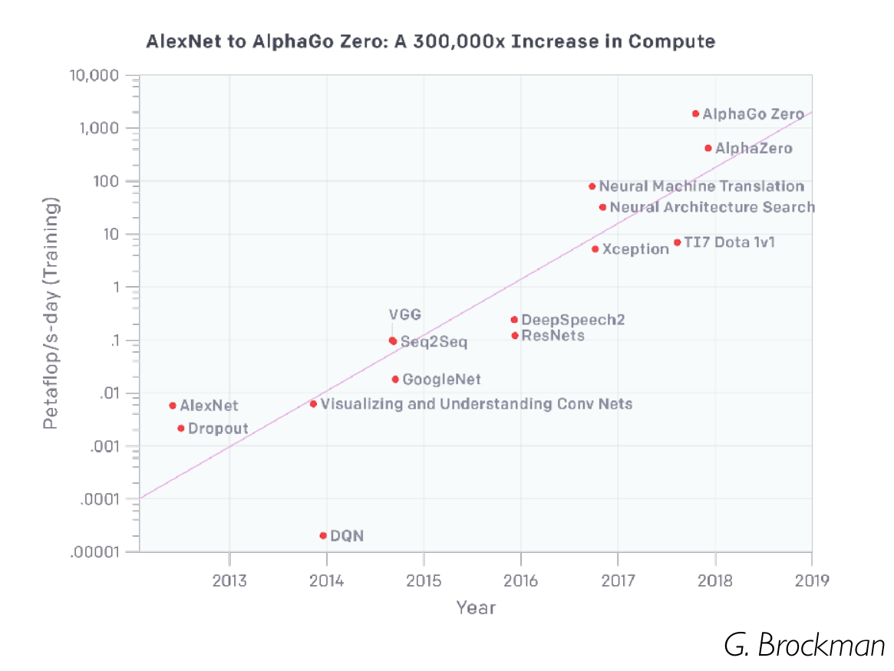
The Path to PetaFLOPS - Training
Notes:
These systems also serve as important study points for how we design and apply parallel processing, particularly in the context of training large-scale AI systems.
Modern AI training workloads are among the most demanding parallel applications we have, requiring coordination across thousands of processors and accelerators working on shared models and datasets.
However, it is worth noting an interesting comparison. The human brain, which weighs roughly 1280 grams and operates at an estimated 20 watts of power, is still performing tasks that our largest computing systems—machines weighing tons and consuming megawatts of power—struggle to replicate efficiently.
This suggests that while we have made significant advances in parallel computing, we have not yet discovered the “secret sauce” that allows biological systems to achieve such efficient and flexible computation. Understanding that gap is one of the major challenges—and opportunities—in modern computing

Slide 12

Michael Flynn’s Hardware Taxonomy
I: Instruction Stream D: Data Stream
SI: Single Instruction Stream (a)
  All processors execute the same instruction in the same cycle
  Instruction may be conditional
  in Multiprocessors, control processor issues the instruction
MI: Multiple Instruction Stream (c)
  Different processors may be simultaneously executing different instructions
SD: Single Data Stream (d)
  All processors operate on the same data item (e.g., copies of it) at the same time
MD: Multiple Data Stream (b)
  Different processors may be simultaneously operating on different data items
  Multiplying a coefficient vector by a data vector (e.g., in filtering)
  y[i] := c[i] × x[i], 0 ≤ i < n
Notes:
Flynn’s taxonomy provides a way to classify computer architectures based on how they handle instruction streams and data streams. Specifically, it considers whether a system is operating on a single or multiple instruction streams, and a single or multiple data streams.
There are four categories in this classification.
The first is SISD — Single Instruction, Single Data. This is the traditional uniprocessor model, where one instruction operates on one piece of data at a time. This is the model we have primarily studied up to this point.
The second is SIMD — Single Instruction, Multiple Data. In this model, a single instruction is applied simultaneously to multiple data elements. This is common in vector processors and modern GPUs, where the same operation is performed across large datasets in parallel.
The third is MISD — Multiple Instruction, Single Data. This is a less common and somewhat theoretical model, where multiple instructions operate on the same data stream. It appears in specialized systems, such as certain fault-tolerant or pipeline-based architectures, but is not widely used in general-purpose computing.
The fourth is MIMD — Multiple Instruction, Multiple Data. This is the most general and widely used model today. In MIMD systems, multiple processors execute different instructions on different data simultaneously. This includes multicore processors, multiprocessor systems, and distributed systems.
The key takeaway is that this taxonomy helps us understand the different ways parallelism can be structured at the architectural level. As we move forward, most of the systems we study will fall into the SIMD and MIMD categories, as these dominate modern high-performance computing.

Slide 13
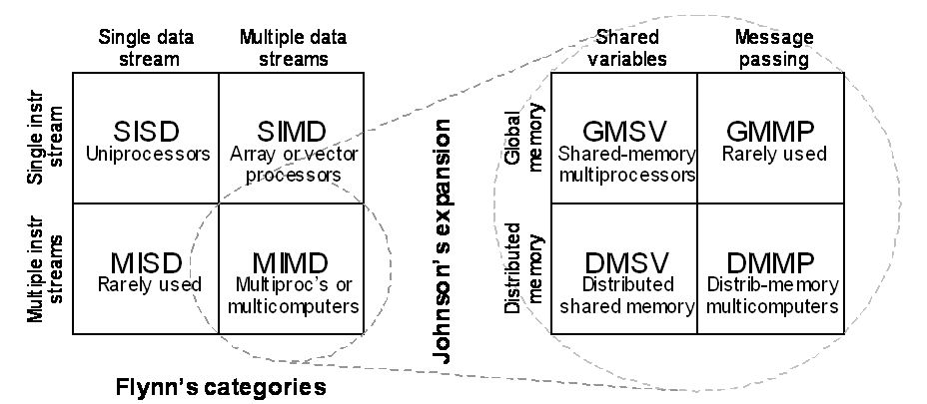
Taxonomy Visual
Notes:
Johnson’s Expansion is a representation that argues that Flynn’s 1966 taxonomy is incomplete when applied to massively parallel architectures. Johnson argues that you must include how processors communicate to get the full architectural picture. Definition of a parallel system according to this expansion says that a parallel architecture includes computation, communication and coordination.
This presents a parallel computer is a collection of processors that cooperate and communicate.
As this expansion occurs across processors—whether on the same chip or across distributed systems—it introduces the need for synchronization and data sharing. Independent execution paths must coordinate their results, respect ordering constraints, and ensure correctness of shared data.
Multiprocessor systems can be organized around global memory, where all processors see the same memory space, or distributed memory, where each processor has its own local memory. Distributed memory systems scale more effectively, because global memory systems face physical and architectural limitations when trying to maintain a single shared address space across many processors.
In terms of programming models, we distinguish between shared variables and message passing. Shared variable models allow multiple processors to read and write common memory locations, which simplifies programming but introduces challenges in synchronization and consistency. Message passing, on the other hand, requires explicit send and receive operations, making it more complex to implement but often more scalable.
Both shared variable and message passing approaches can be used in global and distributed memory systems. However, as systems scale, shared variable models struggle to provide uniform memory access across all processors. In contrast, message passing becomes the dominant approach in large-scale distributed systems, even though it requires more explicit coordination.
In systems with true global memory, message passing is generally considered inefficient compared to direct memory access, since it adds unnecessary overhead on top of an already shared address space.

Slide 14
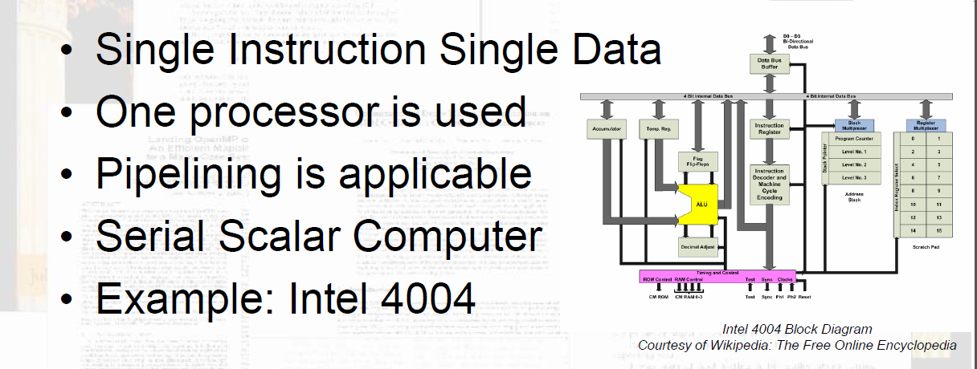
SISD
This model has been the subject of previous lectures.
Notes:
In this model, a single instruction stream operates on a single data stream. This means that at any given time, one instruction is being executed on one piece of data.
This is the model we have been studying throughout most of this course, including instruction execution, control flow, and memory access.
Even though modern processors include features such as pipelining and limited forms of instruction-level parallelism, the programmer’s view of the system remains largely SISD—one program executing a sequence of instructions.
The key point is that SISD systems do not inherently exploit parallelism across multiple processors. Any performance improvements come from making a single instruction stream execute more efficiently, rather than executing multiple instruction streams concurrently.
As we move into SIMD and MIMD systems, we will see how this model expands to take advantage of multiple data elements and multiple instruction streams.
This is the machine you already understand from our coverage. Everything else could be considered an extension of this model given that the construction encapsulates instruction execution.

Slide 15
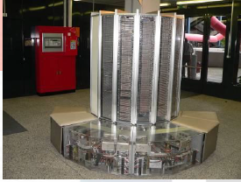
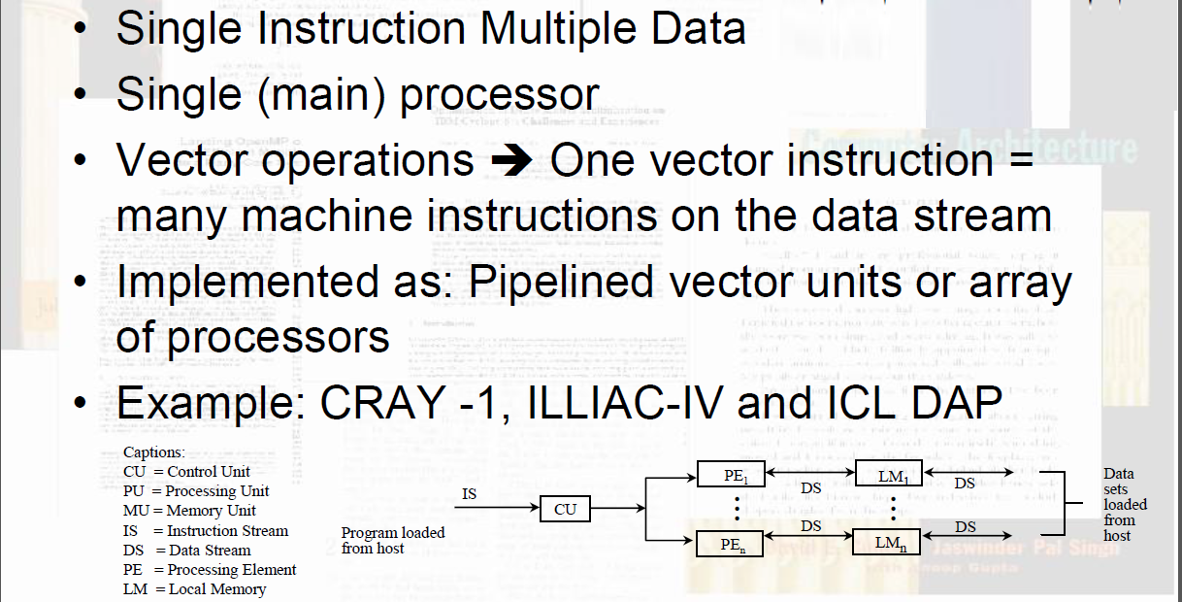
SIMD
Cray-1
Notes:
SIMD stands for Single Instruction, Multiple Data. In this model, a single instruction is applied simultaneously to multiple data elements.
Instead of executing one operation on one piece of data at a time, SIMD allows us to perform the same operation across an entire set of data in parallel.
A simple example is adding two arrays. In a traditional SISD model, we would loop through the arrays and add each pair of elements one at a time. In a SIMD system, a single instruction can add multiple pairs of elements simultaneously.
This model is particularly effective when the same computation must be applied repeatedly across large datasets. That is why SIMD is widely used in graphics processing, scientific computing, and AI workloads. For example, in image processing, the same operation may be applied to every pixel in an image at once.
Modern GPUs are a strong example of SIMD-style execution. They are designed to perform the same instruction across many data elements in parallel, making them highly efficient for workloads with regular, structured data.
However, SIMD has limitations. It works best when all data elements can follow the same instruction path. If different data elements require different operations, the efficiency of SIMD decreases.
The key takeaway is that SIMD provides high performance when there is a high degree of data parallelism, but it is less effective when computations require divergent control flow.

Slide 16

SIMD
Execute one operation on multiple data streams
  concurrency in time – vector processing
  concurrency in space – array processing
CM-1 (SIMD)
CM-5 (MIMD)
Thinking Machines, Inc. Connection Machines
Notes:
Another important historical example of SIMD architecture is the Connection Machine, developed by Danny Hillis. This system used thousands of simple processors, all executing the same instruction simultaneously, each operating on its own local data. This represents a pure form of SIMD and demonstrates how large-scale parallelism can be achieved through coordination of many simple processing elements.
This also leads us to an important distinction between concurrency in time and concurrency in space.
Concurrency in time refers to overlapping execution within a single processor, such as pipelining or instruction-level parallelism, where different stages of instructions are executed at different times but overlap in execution.
Concurrency in space refers to multiple processing elements operating simultaneously in parallel. SIMD systems, such as the Connection Machine or modern GPUs, are examples of concurrency in space, where many processors perform the same operation at the same time on different data.
The key distinction is that concurrency in time improves utilization of a single processing unit, while concurrency in space increases computational capability by adding more processing elements.
As we move into larger-scale systems, most performance gains come from concurrency in space, but both forms are often used together in modern architectures.

Slide 17
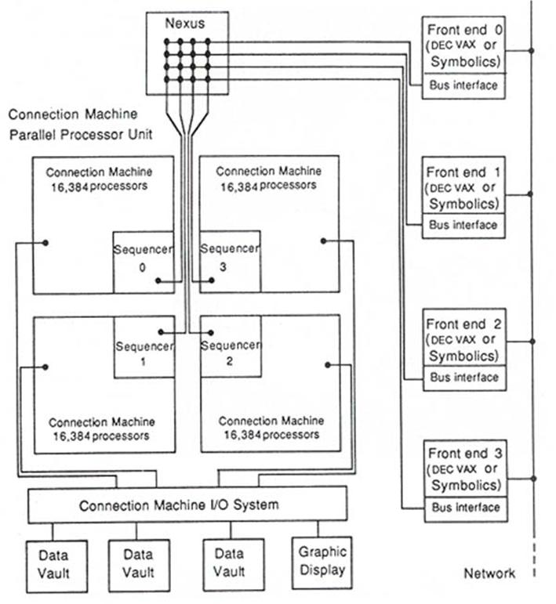
Thinking Machines CM-1
Notes:
The Connection Machine CM-1, introduced in the mid-1980s, around 1985, by Thinking Machines Corporation, is one of the earliest and most striking examples of a large-scale SIMD system.
The CM-1 consisted of up to 65,536 simple processors, each with a small amount of local memory. Each processor was extremely simple and operated on single-bit data, meaning each processor handled just one bit at a time.
In true SIMD fashion, a single control unit broadcast the same instruction to all processors, and each processor executed that instruction on its own local data. This is a pure example of concurrency in space—many processing elements working simultaneously.
The processors were connected through a hypercube interconnection network, allowing them to exchange data efficiently. This was critical, because even though each processor had local memory, many problems required communication between processors.
The CM-1 was particularly well suited for problems involving large datasets and uniform operations, such as artificial intelligence research, image processing, and simulations.
However, the system also highlighted a key limitation of SIMD architectures. If different processors needed to follow different instruction paths, efficiency dropped, because the system was fundamentally designed for a single instruction stream.
The CM-1 represents an important step in the evolution of parallel computing. It demonstrated that massive parallelism could be achieved by coordinating many simple processors, an idea that continues today in modern GPUs and large-scale AI systems.

Slide 18
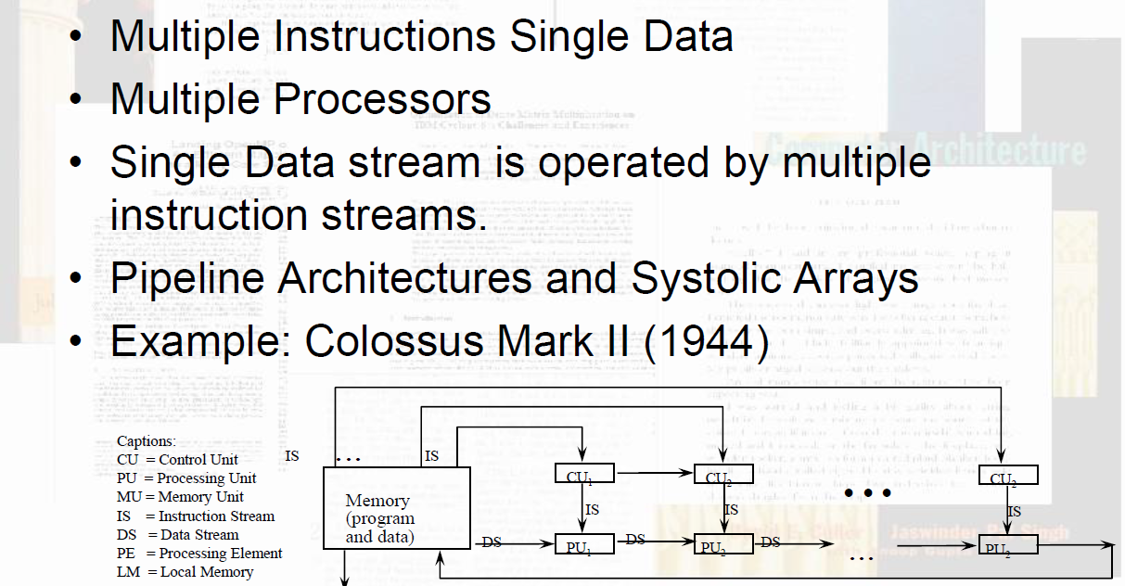
MISD
Colossus Mark II

Slide 19
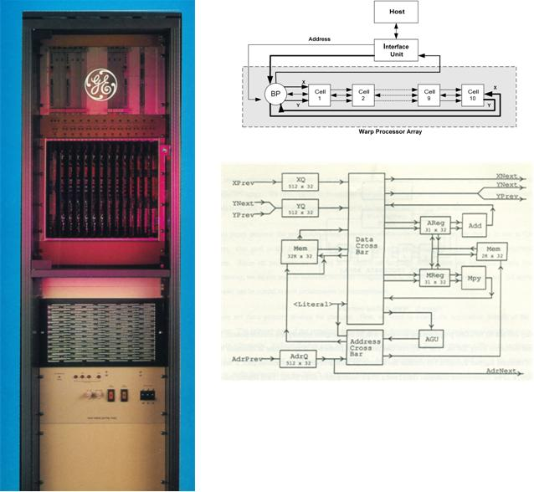
CMU/GE WARP
1987: 100 MFLOPS for $300,000; about 30 times cheaper than a Cray-1 (also 100 MFLOPS) @ $10M
Limited programming models, however.
Example: WARP Systolic Array
Designed by H.T. Kung at CMU (now at Harvard)
Built by General Electric for me for the DARPA Strategic Computing Program (ca 1986-1987)
Notes:
WARP represents a different approach to achieving high performance, focusing on the idea of pipelined computation across multiple functional stages.
In this model, a computation is broken into a sequence of stages, where each stage performs part of the overall operation. Data flows through these stages, and multiple data elements can be processed simultaneously, each at a different stage in the pipeline.
This is an example of concurrency in time, where overlapping execution allows multiple operations to be in progress at once, even though each individual stage may be performing a different function.
Unlike SIMD systems, where many processors perform the same instruction on different data, WARP systems may have different stages performing different operations on a stream of data.
This makes WARP more flexible for certain types of computations, particularly those that can be structured as a sequence of transformations.
However, like all pipelined systems, performance depends on keeping all stages busy. If one stage becomes a bottleneck, it limits the overall throughput of the system.
The key takeaway is that WARP demonstrates another dimension of parallelism—not by replicating processors, but by organizing computation into a flowing pipeline of operations.

Slide 20
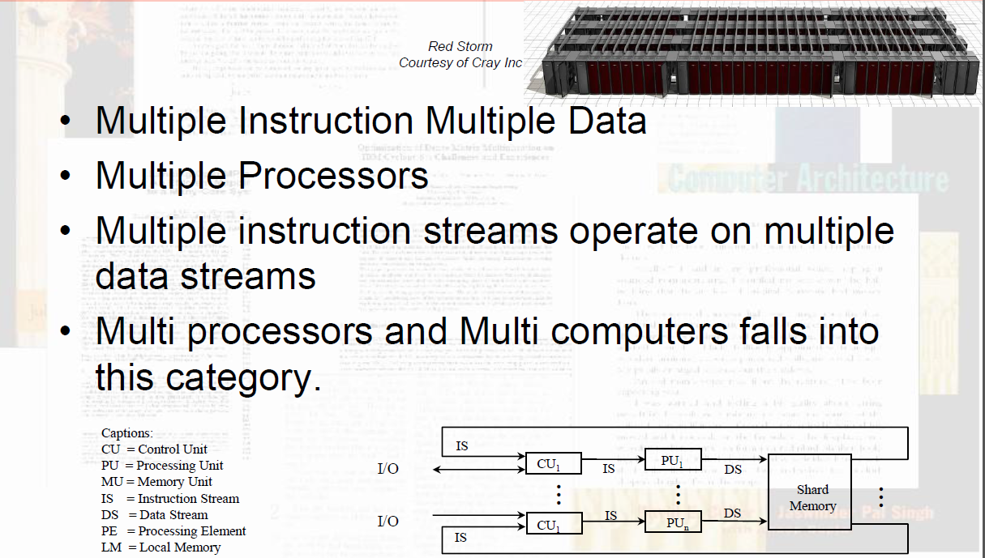
MIMD
Notes:
MIMD stands for Multiple Instruction, Multiple Data, and represents the most general and widely used form of parallel computing today.
In this model, multiple processors execute different instruction streams on different data simultaneously. Each processor operates independently, with its own control flow, and may be running entirely different programs or different parts of the same program.
This is the model used in modern multicore processors, multiprocessor systems, and distributed computing environments.
Unlike SIMD, where all processors must follow the same instruction, MIMD allows for much greater flexibility. Different processors can take different execution paths, handle different tasks, and respond to different events.
However, this flexibility introduces complexity. Processors must coordinate through synchronization and communication, especially when they share data or depend on each other’s results.
MIMD systems can be implemented using either shared memory or distributed memory architectures. Shared memory systems allow processors to communicate through common variables, while distributed systems rely on message passing between processors.
The key takeaway is that MIMD provides the highest level of flexibility and scalability, but also requires the most sophisticated coordination mechanisms to manage parallel execution effectively.
Why is MIMD harder to program than SIMD? (coordination, synchronization, communication)

Slide 21
Processor Coupling back to Johnson’s Expansion – communicate, coordinate, synchronize
Tightly Coupled System
  Tasks and/or processors communicate in a highly synchronized fashion
  Communicates through a common shared memory
  Shared memory system
Loosely Coupled System
  Tasks or processors do not communicate in a synchronized fashion
  Communicates by message passing packets
  Overhead for data exchange is high
  Distributed memory system
Notes:
Processor coupling refers to how closely multiple processors are connected and how they communicate and share resources. It describes the degree of interaction between processors in a multiprocessor system.
At one end of the spectrum, we have tightly coupled systems. In these systems, processors share a common global memory and are connected through a high-speed interconnect. Communication between processors is fast, and synchronization can be done efficiently through shared variables. This type of system is typically found in multicore processors and shared-memory multiprocessors. It is easier to program because all processors operate within a single address space.
At the other end, we have loosely coupled systems, also known as distributed systems. In these systems, each processor has its own local memory, and processors communicate through message passing over a network. Communication in loosely coupled systems is slower and requires explicit coordination, but these systems scale much more effectively. This is the model used in clusters, cloud computing environments, and large-scale AI training systems.
The key tradeoff is between ease of programming and communication speed in tightly coupled systems, versus scalability and flexibility in loosely coupled systems.
As systems grow larger, architectures tend to move from tightly coupled toward more loosely coupled designs, because maintaining a single shared memory becomes impractical at scale.

Slide 22
Granularity of Parallelism
Coarse-grain
  A task is broken into a handful of pieces, each of which is executed by a powerful processor
  Processors may be heterogeneous
  Computation/communication ratio is very high
  Example: BBN Butterfly
Medium-grain
  Tens to few thousands of processors typically running the same code
  Computation/communication ratio is often hundreds or more
  Intel Paragon XP, Touchstone Series
Fine-grain
  Thousands to perhaps millions of small pieces, executed by very small, simple processors or through pipelines
  Processors typically have instructions broadcasted to them
  Compute/communicate ratio often near unity
  Example: Thinking Machines CM-1, CM-2, CM-200
Notes:
If we look at Granularity from a different perspective, Granularity refers to the size of the computational tasks in a parallel system and how frequently those tasks must communicate or synchronize with one another. It is best understood as the ratio of computation to communication.
In fine-grained systems, tasks are very small and communication occurs frequently, such as in instruction-level parallelism or tightly coupled threads sharing memory. While this allows for a high degree of parallelism, the overhead of communication and synchronization can significantly limit performance.
Medium-grained systems represent a balance, where tasks are larger and communication occurs less frequently but still on a regular basis; this is typical of processes on the same machine or NUMA systems.
Coarse-grained systems consist of large, relatively independent tasks that communicate infrequently, as seen in distributed systems and clusters where each node runs its own operating system. These systems scale well because communication is minimized, but when communication does occur, it is more expensive and requires explicit coordination. As systems become more distributed, granularity becomes coarser, reducing communication frequency but increasing communication cost. Ultimately, the performance of a parallel system depends on matching the granularity of the application to the architecture, ensuring that the cost of communication does not outweigh the benefits of parallel execution.

Slide 23
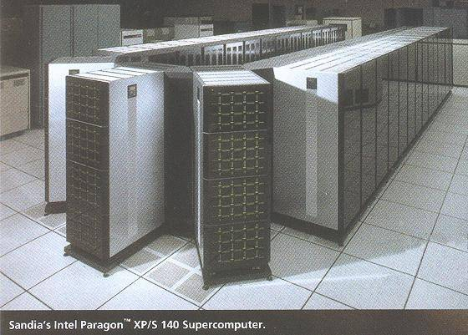
Intel Paragon XP/S 140 Supercomputer
Notes:
The Intel Paragon represents an early and influential example of a large-scale distributed memory parallel system. Developed in the early 1990s by Intel, the Paragon was designed to achieve massively parallel computation by connecting hundreds to thousands of independent processing nodes. Each node operated with its own processor, memory, and operating system environment, making the system a clear example of a coarse-grained, loosely coupled architecture. Rather than relying on shared memory, the Paragon used message passing for communication between nodes, which allowed it to scale far beyond the limits of traditional shared-memory systems.
The architecture was based on a high-speed interconnection network arranged in a two-dimensional mesh, enabling processors to communicate with neighboring nodes efficiently. This design reduced bottlenecks associated with centralized memory access and allowed the system to maintain performance as more nodes were added. However, because there was no global shared memory, programmers were required to explicitly manage communication and data distribution, typically using message passing libraries. This increased programming complexity but provided much greater scalability.
The Intel Paragon demonstrated that large-scale parallel systems could be built using distributed memory and explicit communication, influencing later developments in high-performance computing clusters. It fits squarely into the progression from NUMA systems to fully distributed systems with individual operating systems, illustrating the tradeoff between ease of programming and scalability. The system showed that as architectures move toward coarse-grained parallelism, communication becomes a dominant factor in performance, reinforcing the importance of designing applications that minimize communication overhead while maximizing independent computation.

Slide 24
Memory Architectures
Shared (Global) Memory
  A Global Memory Space accessible by all processors
  Processors may also have some local memory
Distributed (Local, Message-Passing) Memory
  All memory units are associated with processors
  To retrieve information from another processor's memory a message must be sent there
Uniform Memory : All processors take the same time to reach all memory locations
Non-uniform (NUMA) Memory: Processors have varying access patterns to shared memory
Notes:
Memory architecture defines how memory is organized and accessed in a parallel system, and it has a direct impact on performance, scalability, and programming complexity. At a high level, memory architectures can be divided into two primary categories: shared memory and distributed memory, with hybrid approaches such as NUMA combining aspects of both. The choice of memory architecture determines how processors communicate, how data is shared, and how efficiently the system can scale.
Modern systems often use hybrid memory architectures that combine shared and distributed approaches. For example, a cluster may consist of multiple NUMA nodes, each with shared memory internally, but communicating with other nodes through message passing. This reflects the broader trend in parallel computing: as systems scale, they move from simple shared memory models toward more distributed designs, trading ease of programming for improved scalability and performance.

Slide 25
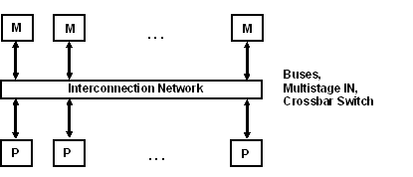
Shared Memory Multiprocessors
Characteristics
  All processors have equally direct access to one large memory address space
Example systems
  Bus and cache-based systems: Sequent Balance, Encore Multimax
  Multistage IN-based systems: Ultracomputer, Butterfly, RP3, HEP
  Crossbar switch-based systems: C.mmp, Alliant FX/8
Limitations
  Memory access latency; Hot spot problem
Notes:
In shared memory systems, all processors have access to a single global memory space. This model is simple from a programming perspective because processes can communicate through shared variables. Uniform Memory Access (UMA) systems provide equal access time to all memory locations, but they do not scale well due to contention for the shared memory bus. Non-Uniform Memory Access (NUMA) improves scalability by physically distributing memory across processors while maintaining a shared address space. However, access times vary depending on whether memory is local or remote, making data placement and locality critical for performance.

Slide 26
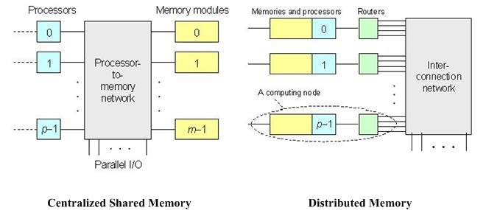
Centralized Shared vs. Distributed Memory
Large caches – single memory serves small number of processes (up to 16 or so)
More processors introduces more contention
Pro: reduces latency of local memory accesses
Con: communicating data between processors becomes more complex
Notes:
In distributed memory systems, each processor has its own private memory, and there is no global address space. Communication between processors must be done explicitly through message passing. This model eliminates shared memory bottlenecks and allows systems to scale to very large sizes, as seen in clusters and supercomputers. However, it places a greater burden on the programmer to manage communication, synchronization, and data distribution.

Slide 27
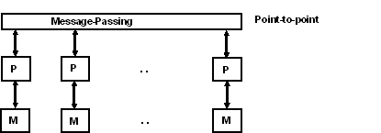
Message Passing Multiprocessors
Characteristics
  Interconnected computers
  Each processor has its own memory, and communicates via message-passing
  Messages are variable-length data containers
Example systems
  Tree structure: Teradata, DADO
  Mesh-connected: Rediflow, Series 2010, J-Machine
  Hypercube: Cosmic Cube, iPSC, NCUBE, FPS T Series, Mark III
Notes:
Message passing multiprocessors are systems in which each processor has its own private memory, and all communication between processors occurs through the explicit exchange of messages. Unlike shared memory systems, there is no global address space, so processors cannot directly read or write each other’s memory. Instead, data must be sent and received using defined communication operations, typically implemented through libraries such as MPI. This model is characteristic of distributed memory systems and is commonly used in clusters and large-scale supercomputers.
In these systems, communication is explicit and must be carefully managed by the programmer. A processor that needs data from another must issue a send request, and the receiving processor must issue a corresponding receive operation. This introduces additional complexity, as synchronization must be coordinated and communication patterns must be designed to avoid delays or deadlocks. However, this explicit control also allows for greater scalability, since there is no contention for a shared memory system and no need for complex cache coherence mechanisms.
Message passing architectures are typically organized using high-speed interconnection networks, such as meshes, tori, or switched networks, which connect processors and allow data to move between them efficiently. The performance of these systems is heavily influenced by communication costs, including latency and bandwidth. As a result, efficient programs are designed to minimize communication, overlap communication with computation when possible, and partition data in a way that reduces the need for frequent data exchange.
Overall, message passing multiprocessors represent the most scalable form of parallel architecture. They are well suited for coarse-grained parallelism, where tasks are large and relatively independent. While they require more effort to program compared to shared memory systems, they enable computation at a scale that would not be possible otherwise, making them the foundation of modern high-performance computing systems.

Slide 28
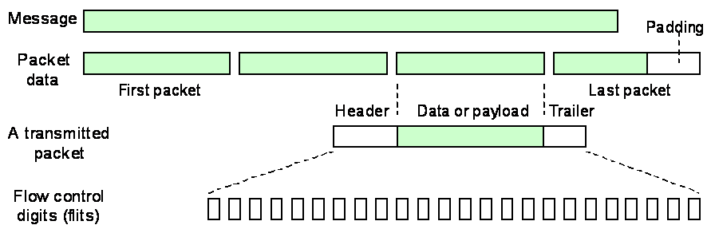
Message Passing Multiprocessors
One-to-one communication: one source, one destination
Collective communication
  One-to-many: multicast, broadcast (one-to-all), scatter
  Many-to-one: combine (fan-in), global combine, gather
  Many-to-many: all-to-all broadcast (gossiping), scatter-gather
Notes:
In message passing multiprocessors, communication between processors occurs through the exchange of packets over an interconnection network. When a processor needs to send data to another, the message is broken into smaller units called packets, which are then transmitted across the network. Each packet contains not only the data, but also control information such as the destination address, allowing it to be routed independently through the system.
These packets travel through the network using switching elements such as routers or nodes, which forward the packets toward their destination. Depending on the routing strategy and network topology, packets may take different paths and may arrive out of order, requiring reassembly at the destination. This packet-based approach allows multiple communications to occur simultaneously, improving overall system throughput and enabling the network to scale as more processors are added.
However, packet-based communication introduces additional overhead. Each packet must be processed, routed, and potentially buffered, which adds latency. Contention can occur when multiple packets attempt to use the same network links, leading to delays. As a result, the performance of message passing systems is heavily dependent on the efficiency of the interconnection network and the communication patterns of the application.
This slide highlights that in distributed systems, communication is no longer a simple memory access but a structured transfer of packets across a network. The cost of this communication—both in latency and bandwidth—becomes a critical factor in system performance, reinforcing the importance of designing algorithms that minimize communication and maximize local computation.

Slide 29
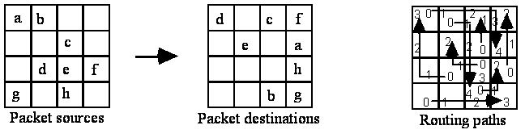
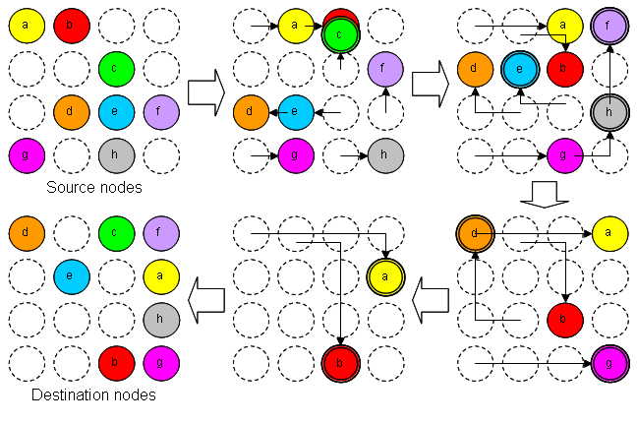
Message Routing
Notes:
Message routing refers to how data is transferred between processors in a distributed or loosely coupled system. Since each processor has its own local memory, communication must occur through messages sent across an interconnection network.
The goal of message routing is to deliver messages from a source processor to a destination processor efficiently, reliably, and with minimal delay.
This requires a network topology, such as a mesh, ring, bus, or hypercube, and a routing strategy that determines the path a message takes through that network.
Routing can be either static or dynamic. In static routing, paths are predetermined, which simplifies implementation but may not adapt well to congestion or failures. In dynamic routing, paths are determined at runtime, allowing the system to avoid congested or failed links, but adding complexity.
Another important concept is contention. When multiple processors attempt to use the same communication path at the same time, delays can occur. This can significantly impact performance, especially in large systems.
Latency and bandwidth are also critical factors. Latency refers to the time it takes for a message to travel from source to destination, while bandwidth refers to how much data can be transmitted over time.
The key takeaway is that in distributed systems, communication cost can dominate computation cost. Efficient message routing is therefore essential to achieving good performance in parallel systems.

Slide 30
Non-Uniform Memory Access
All memories can be addressed by all processors, but access to a processor’s own local memory is faster than access to another processor’s remote memory.
  Looks like a distributed machine, but the interconnection network is usually custom-designed switches and/or buses.
CC-NUMA: Cache Coherent NUMA
  Exemplified by Kendall Square Research KSR1
Notes:
In Non-Uniform Memory Access (NUMA) systems, memory is physically distributed across processors, but logically shared.
Each processor can access all memory, but access time varies depending on whether the memory is local or remote.
NUMA improves scalability by reducing contention for a single memory bus, however it introduces performance challenges related to data locality. Efficient NUMA systems require careful management of memory placement and processor affinity to minimize remote memory access.

Slide 31
Operating System Support
Individual OS
  Each CPU has its own OS
  Statically allocate physical memory to each CPU
  Each CPU runs its own independents OS
  Share peripherals
  Each CPU handles its processes system calls
  Used in early multiprocessor systems
  Simple to implement
  Avoids concurrency issues by not sharing

Slide 32
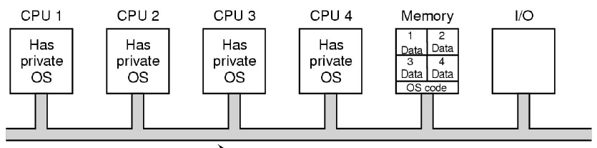
Operating System Support
Individual OS Issues:
  Each processor has its own scheduling queue.
  Each processor has its own memory partition.
  Consistency is an issue with independent disk buffer caches and potentially shared files.
Notes:
In systems where each processor runs its own operating system, challenges arise due to the lack of a shared global environment. Unlike shared-memory systems, where a single OS manages all resources, each node in an individual OS system operates independently. There is no inherent global view of memory, processes, or system state, making coordination across the system more complex. Tasks such as process management, scheduling, and resource allocation must be handled locally on each node, while still supporting cooperation across the distributed system.
Primary issues include communication and synchronization. Since there is no shared memory, all coordination must occur through message passing, which introduces latency and requires explicit programming. Ensuring that processes remain synchronized across nodes can be difficult, particularly in the presence of variable communication delays. This also raises the possibility of deadlock or race conditions if communication is not carefully designed.
Another significant challenge is data consistency and distribution. Because each node maintains its own memory, data must be explicitly partitioned and distributed across the system. Keeping data consistent across nodes requires additional communication and coordination, especially when updates occur. Unlike shared memory systems where coherence is handled by hardware, distributed systems rely on software mechanisms, increasing complexity and overhead.
Fault tolerance and system management also become more important in individual OS systems. Since each node operates independently, failures can occur at any point in the system. While this can improve robustness by isolating failures, it also requires mechanisms to detect, recover from, or compensate for node failures. Additionally, debugging and performance monitoring are more difficult because there is no single point of control; developers must consider the behavior of multiple interacting systems rather than a single unified environment.
Overall, individual OS systems offer excellent scalability but introduce significant challenges in communication, synchronization, data management, and system coordination. These issues highlight the tradeoff between scalability and complexity, reinforcing the need for careful system and application design in distributed environments.

Slide 33
Operating System Support
Master-Slave Multiprocessors
  OS mostly runs on a single fixed CPU.
  User-level applications run on the other CPUs.
  All system calls are passed to the Master CPU for processing
  Very little synchronization required
  Single to implement
  Single centralized scheduler to keep all processors busy
  Memory can be allocated as needed to all CPUs.
Issues: Master CPU becomes the bottleneck.
Notes:
Master–slave multiprocessors are a class of parallel systems in which one processor, known as the master, controls the overall execution of the program, while the remaining processors, called slaves, perform tasks assigned to them. The master processor is responsible for scheduling work, distributing tasks, managing data, and coordinating communication, while the slave processors execute the computations and return results to the master. This creates a centralized control structure that simplifies coordination compared to fully distributed systems.
In this model, the master acts as the primary decision-maker, determining what work needs to be done and assigning it to available slave processors. Slaves do not typically initiate work on their own; instead, they wait for instructions from the master. This makes the programming model relatively straightforward, as the complexity of task management and synchronization is concentrated in one place. It is particularly useful for applications where work can be divided into independent tasks that can be processed in parallel and then combined.

Slide 34
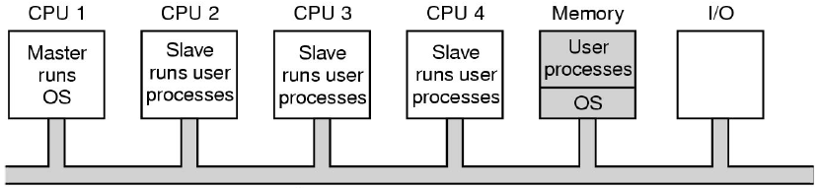
Operating System Support
Master-Slave Multiprocessors Issues:
Master CPU becomes the bottleneck.
Notes:
However, the master–slave model introduces potential performance limitations. The master can become a bottleneck if it is responsible for too many tasks, as all communication and coordination must pass through it. As the number of slave processors increases, the master may struggle to keep all processors busy, reducing overall efficiency. This limits the scalability of the model compared to more distributed approaches, where coordination is shared among multiple processors.
Despite these limitations, master–slave multiprocessors are effective for certain types of problems, especially those with clear task decomposition and centralized control requirements. They are often used in early parallel systems and in applications such as task farming, where a central controller distributes independent jobs to a pool of workers. This model highlights the tradeoff between simplicity and scalability, providing an important contrast to fully distributed systems where control is decentralized.

Slide 35
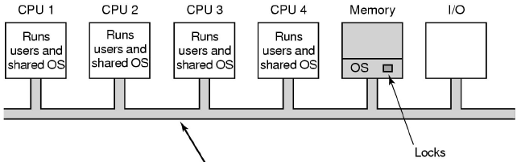
Operating System Support – Symmetric MP
OS kernel runs on all processors, while load and resources are balanced between all processors.
One alternative: A single mutex (mutual exclusion object) that make the entire kernel a large critical section; Only one CPU can be in the kernel at a time; Only slight better than master-slave
Better alternative: Identify independent parts of the kernel and make each of them their own critical section, which allows parallelism in the kernel
Issues: A difficult task; Code is mostly similar to uniprocessor code; hard part is identifying independent parts that don’t interfere with each other
Notes:
Symmetric multiprocessing, or SMP, refers to a system in which multiple processors share a common memory and are managed by a single operating system.
In an SMP system, all processors are treated equally. Each processor can execute any task, access the same memory, and run the same operating system code. There is no master or slave processor—control is distributed evenly across all processors.
The operating system is responsible for scheduling tasks across the available processors. It decides which processor runs which process or thread, with the goal of balancing load and maximizing performance.
Because all processors share the same memory, communication between them is relatively fast and is typically done through shared variables. However, this also introduces challenges related to synchronization and data consistency.
The operating system must provide mechanisms such as locks, semaphores, and critical sections to ensure that multiple processors do not interfere with each other when accessing shared data.
SMP systems are widely used in modern multicore processors, where multiple cores operate under a single OS image.
The key tradeoff is that while SMP systems are easier to program due to shared memory, they face scalability limits. As the number of processors increases, maintaining a consistent and coherent view of memory becomes more difficult and can become a performance bottleneck.
SMP = one OS, shared memory, and similar/equal processors

Slide 36

Interconnection Topologies
Shared Bus:
  M3 wishes to communicate with S5
  [1] M3 sends signals (address) on the bus that causes S5 to respond
  [2] M3 sends data to S5 or S5 sends data to M3 (determined by the command line)
Master Device: Device that initiates and controls the communication
Slave Device: Responding device
Multiple-master buses: Bus conflict requires bus arbitration
Notes:
Now we want to focus on bus-based interconnection, where all processors and devices share a common communication pathway. Because only one device can use the bus at a time, the system must determine which device gets access when multiple requests occur simultaneously. This is handled through bus arbitration, often based on priority.
Devices may be assigned fixed priorities, where certain processors or I/O devices always have precedence over others. For example, a real-time I/O device might be given higher priority than a general-purpose processor.
Alternatively, systems may use dynamic or rotating priority schemes, such as round-robin arbitration, to ensure fairness and prevent starvation of lower-priority devices. The key issue in bus-based systems is contention. When many devices attempt to use the bus, delays increase because access must be serialized. Higher-priority devices may proceed quickly, while lower-priority devices may experience longer wait times. This creates a tradeoff between performance and fairness.
Prioritization improves responsiveness for critical devices but can lead to uneven resource access across the system.
While bus-based interconnection is simple and effective for small systems, it becomes a bottleneck as the number of processors and devices increases, particularly when priority-based arbitration is required.

Slide 37
Interconnection Topologies
Shared Bus: A collection of signal lines that carry module-to-module communication
  Again, all processors (and memory) are connected to the common bus or busses
  Memory access is fairly uniform, but not very scalable
  Data highways connecting several digital system elements
  Can handle only one data transmission at a time
  Can be easily expanded by connecting additional processors to the shared bus, along with the necessary bus arbitration circuitry
Interconnection Networks:
  Attempt to mitigate the issues present within single, shared buses
  Vary according to the primary or sets of objectives that are defined by the purpose of the interconnect.
Notes:
As we now understand the shared bus concept and its limitations, we will look at alternative ways to interconnect the nodes within massively parallel systems.
Interconnection topologies that have emerged through research efforts have benefits and issues according to the communications environments for which they were designed.

Slide 38
Network Terminology
Diameter: D of a network having N nodes is defined as the maximum shortest path of all the shortest paths between any two nodes in the network.
Bisection bandwidth: If a network is divided into two partitions, the bisection bandwidth of a network topology is the bandwidth available between the two partitions.
Bisection = 1
D = 3
Bisection = 2
D = 2
Bisection = 2
D = 3
Notes:
To understand interconnection networks, we need a set of basic terms that describe how processors communicate.
A node refers to a processor or device in the system.
A link is the physical or logical connection between nodes. Messages travel across links from one node to another.
The topology describes how nodes are connected—such as bus, ring, mesh, or hypercube—and determines the possible paths messages can take.
A path is the route a message follows through the network, and each step along that path is called a hop. The number of hops affects how long it takes for a message to reach its destination.
Latency refers to the time it takes for a message to travel from source to destination.
Bandwidth refers to how much data can be transmitted over a link in a given amount of time.
Another important concept is throughput, which is the overall rate at which the system can successfully deliver messages.
When multiple messages compete for the same resources, we experience contention, which can lead to delays or congestion in the network.
Performance in parallel systems depends not only on computation, but on how efficiently data moves through the network.

Slide 39
Interconnection Topologies Introduction
Interconnection topologies describe how processors are physically connected to each other in a multiprocessor or distributed system. The topology determines how messages travel between processors and has a direct impact on performance, scalability, and complexity.
  One of the simplest topologies is the bus, where all processors share a single communication line. This is easy to implement but does not scale well, because only one communication can occur at a time.
  A ring topology connects each processor to two neighbors, forming a loop. Messages travel around the ring until they reach their destination. This improves scalability over a bus, but latency can increase as the number of processors grows.
  A mesh topology arranges processors in a grid, where each processor connects to its neighbors. This allows for multiple communication paths and improves scalability. Many modern systems use variations of mesh or torus topologies.
  A hypercube topology connects processors in a multidimensional structure, where each node is connected to others based on binary addressing. This provides very efficient communication paths and was used in systems like the Connection Machine.
  There are also trees!
Notes:
The key tradeoffs involve latency, bandwidth, cost, reliability and scalability. Simpler topologies are easier to build but become bottlenecks at scale, while more complex topologies provide better performance but require more sophisticated routing and hardware.
The key takeaway is that the interconnection network is just as important as the processors themselves. Poor communication design can limit the performance of even the most powerful parallel system.

Slide 40
Interconnection Topologies
Mesh Architecture: (square with m rows and m columns):
  Diameter = 2(m - 1)
  In general, an n-processor square mesh has diameter = 2(sqrt(n)-1)
  Diameter can be halved by having wrap-around connections (=> Torus) here with dotted lines.
  Ring is a 1-dimensional mesh with wrap-around connections
Notes:
Diameter gives the max number of links that might be traversed. Typical interprocessor meshes are square. Adding the torus connections increases cost and bisection bandwidth while decreasing diameter. Higher bisection bandwidth implies more reliabilty, but think of the tradeoffs.
Square meshes work to minimize distances and decrease statistical variance.

Slide 41
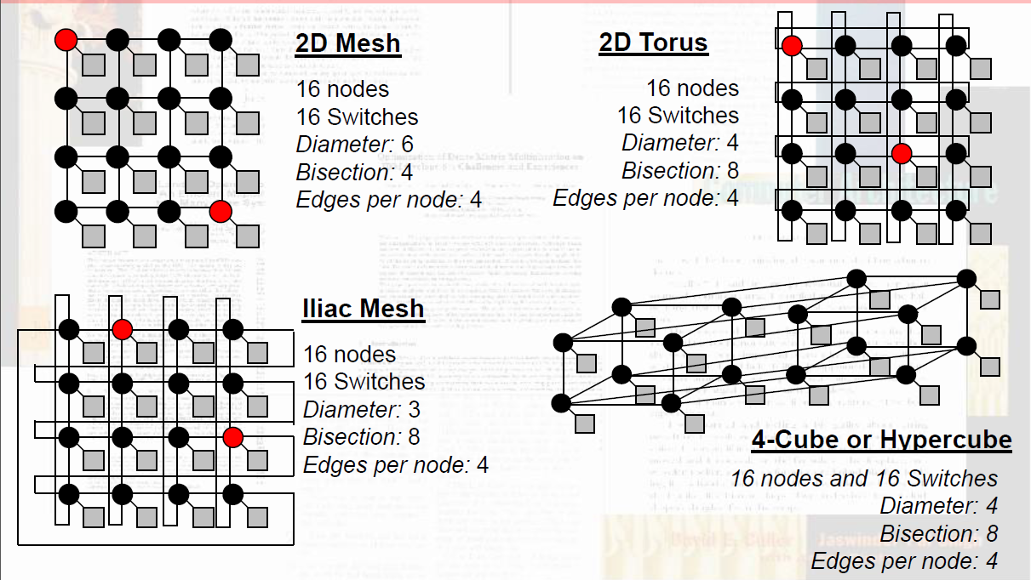
Mesh-Type Interconnects
Notes:
Each processor is connected to its immediate neighbors—typically up, down, left, and right—forming a two-dimensional network. Processors at the edges and corners have fewer connections than those in the interior.
Communication in a mesh occurs through message passing, where data is forwarded from one node to another across the network. Messages may pass through multiple intermediate processors, and each step is called a hop.
The performance of the network depends heavily on the number of hops required to reach a destination. In the worst case, the distance between two nodes is (m − 1) + (n − 1), which defines the diameter of the mesh.
One advantage of mesh interconnects is their regular structure and scalability. As we increase the number of processors, we can expand the grid in a predictable way.
However, as the system grows, the average distance between processors increases, which can increase communication latency and limit performance.
A common enhancement is the torus topology, where the edges wrap around—connecting top to bottom and left to right—reducing the maximum number of hops and improving communication efficiency.
As a point of comparison, another important interconnection structure is the hypercube. In a hypercube with 2^d processors, each processor is connected to d neighbors, where d is the number of dimensions.
Unlike a mesh, where distance grows with the physical size of the grid, the hypercube has a logarithmic diameter, meaning the maximum number of hops between any two processors is d = log₂(p).
This allows hypercube networks to scale more efficiently in terms of communication distance, as the system grows.

Slide 42
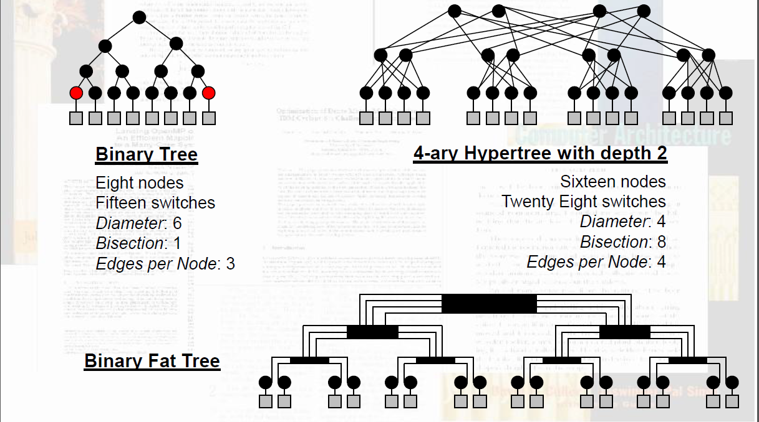
Tree-Type Interconnects
Notes:
This slide illustrates several variations of tree-based interconnection networks, all of which organize processors in a hierarchical structure.
The first type is a binary tree, where each node connects to two child nodes. This creates a simple and balanced structure with predictable growth. Communication between nodes proceeds up the tree to a common ancestor and then back down.
The second type is a k-ary tree, where each node may have more than two children. Increasing the branching factor reduces the overall depth of the tree, which can decrease communication distance, but it also increases the number of connections required at each node. All nodes but leaves have k children.
The third variation is a fat tree, which is designed to address bottlenecks found in simple trees. In a fat tree, links closer to the root have greater bandwidth or are duplicated, allowing more traffic to flow through higher levels of the hierarchy. This improves performance when many nodes communicate simultaneously.
Across all tree structures, communication follows hierarchical paths, and the depth of the tree determines the number of steps required for messages to travel between nodes.
With tree interconnects traffic tends to concentrate near the upper levels, which can create bottlenecks unless additional capacity is provided, as in the fat tree design

Slide 43
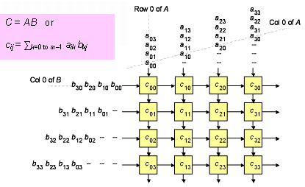
Example: Mesh Matrix Multiplication
Notes:
The mesh, or matrix, interconnection organizes processors in a grid, typically described as an m × n structure, where processors are arranged in rows and columns and communicate with their nearest neighbors.
This structure is especially well suited for problems that can be mapped onto a grid, such as image processing, scientific simulations, and numerical methods where data naturally has spatial relationships.
In many cases, the mesh is implemented as a 2D matrix, where each processor handles a portion of the data and exchanges information with adjacent processors. This allows computations to proceed in parallel while maintaining locality of data.
Several important parallel machines have used mesh or matrix-style interconnects. For example, the ILLIAC IV was an early SIMD machine that organized processing elements in a grid for array-based computations.
Later systems such as the Intel Paragon and the Cray T3D used mesh-based or closely related topologies to support scalable parallel processing.
More modern designs, including many GPU architectures and on-chip networks, continue to use mesh-like interconnects because they map well to physical layouts and scale in a predictable way.
Mesh and matrix interconnects are particularly effective when the structure of the computation matches the structure of the network, allowing efficient local communication and scalable performance.

Slide 44
Interconnection Topologies
Multiport Memory:
  Has multiple sets of address, data, and control pins to allow simultaneous data transfers to occur
  CPU and DMA controller can transfer data concurrently
  A system with more than one CPU could handle simultaneous requests from two different processors
  Does not scale well because of explosion of number of busses
Memory Module Control Logic
  Each memory module has control logic
  Resolve memory module conflicts via fixed priority among CPUs
  Requests to read from and write to the same memory location simultaneously
  Advantages
    Multiple paths -> high transfer rate
  Disadvantages
    Multiple copies of Memory control logic
    Large number of connections

Slide 45
Interconnection Topologies
Crossbar Switch:
  Processors p and Memory banks b are connected to routing switches like in telephone system
  Switches might have queues (combining logic), which improve functionality but increase latency
  Switch settings may be determined by message headers or preset by controller
  Connections can be packet-switched or circuit-switched (remain connected as long as it is needed)
  Nonblocking Switch: the connection of a processing node to a memory bank does not block the connection of any other processing nodes to other memory banks.
Notes:
Older versions used circuit switching where a dedicated path was created for the duration of the communication
More recently, packet switching has been used across the interstitial nodes
Requires p*b switches
Examples of machines that employ crossbars include the Sun Ultra HPC 10000 and the Fujitsu VPP500

Slide 46
Butterfly Network
An example of blocking in omega network: one of the messages
(010 to 111 or 110 to 100) is blocked at link AB.
Notes:
The butterfly network is a multistage interconnection network designed to efficiently route data between processors through a sequence of switching stages. In this structure, processors are connected through multiple levels of switches, and messages move stage by stage toward their destination. The pattern of connections resembles a butterfly, which gives the network its name.
One important characteristic of butterfly networks is that there is typically only one unique path between a given source and destination pair.
This leads to the concept of blocking. Blocking occurs when two or more messages attempt to use the same link or switch at the same time, causing one or more of the messages to be delayed. Because the butterfly network has limited alternate paths, it is considered a blocking network—meaning that contention in one part of the network can prevent other communications from proceeding, even if their endpoints are different.
This is in contrast to non-blocking networks, such as crossbar switches, where multiple independent connections can occur simultaneously without interference. The advantage of the butterfly network is that it provides efficient routing with fewer connections than a fully connected network. However, the tradeoff is the potential for blocking under heavy communication loads.
Butterfly networks are efficient and structured, but their limited path diversity can lead to contention and reduced performance due to blocking.

Slide 47
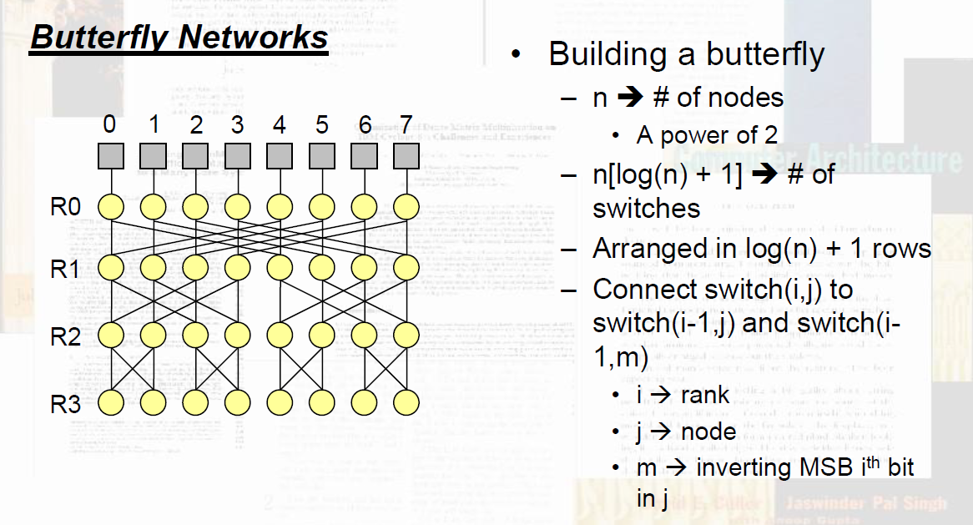
Butterfly Network
Notes:
To understand the butterfly network, it helps to build one step by step.
Start with N processors, where N = 2^d. For example, if d = 3, then we have 8 processors.
Next, create d stages of switching elements between the inputs and outputs. Each stage represents one step in routing the message.
At each stage, processors are connected through 2×2 switches, which can direct data along one of two possible paths. These switches form the core building blocks of the network.
The key idea is that at each stage, the network examines one bit of the destination address and uses that bit to decide which direction to route the message.
As the message progresses through the stages, each stage routes based on the next bit in the destination address, gradually guiding the message to its final destination.
By the time the message passes through all d stages, it has been fully routed to the correct output node.
The pattern of connections between stages creates the characteristic “butterfly” structure, where paths cross and diverge in a regular way.
A butterfly network is built from simple switching elements arranged in stages, with routing decisions made one bit at a time.

Slide 48
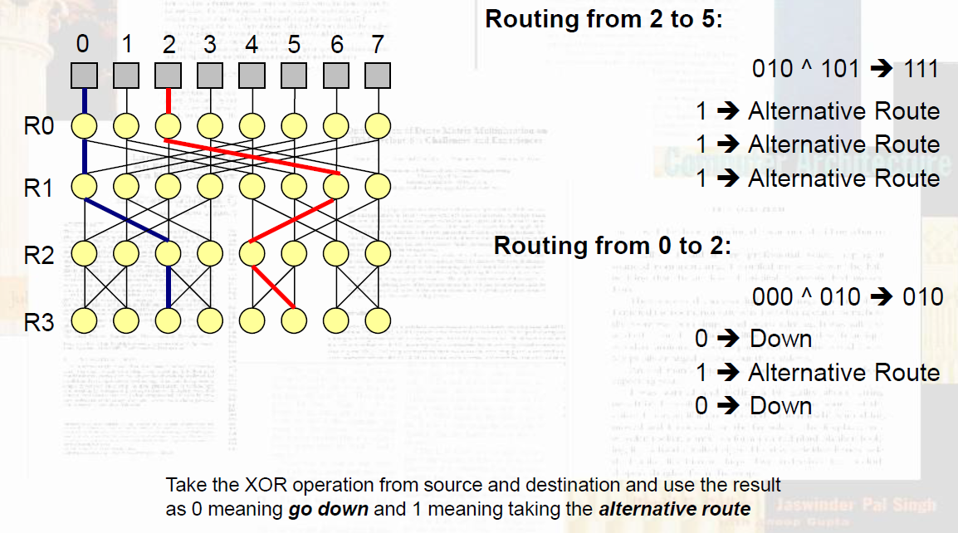
Butterfly Routing

Slide 49
Interconnection Topologies
Omega Network (Butterfly Network)
Consists of log p stages, p is the number of inputs (processing nodes) and also the number of outputs (memory banks)
Each stage consists of an interconnection pattern that connects p inputs and p outputs:
  Perfect shuffle(left rotation):
  Each switch has two connection modes:
    Pass-thought connection: the inputs are sent straight through to the outputs
    Cross-over connection: the inputs to the switching node are crossed over and then sent out.
  Has p*(log p)/2 switching nodes: if p = 8, nodes = 12
    Much better than crossbar using p*p=64 switches
  The cost of such a network grows as (p log p)
Notes:
As butterfly networks grow, the number of processors increases as N = 2^d, where d is the number of stages.
The network itself grows in a structured way, with d stages and N nodes per stage, resulting in a total of N × d switching elements.
This means that the hardware cost of the network grows on the order of N log₂(N), which is significantly more efficient than a fully connected network, such as a crossbar, which grows on the order of N².
However, this cost efficiency comes with tradeoffs. As the network grows, the number of stages increases, which adds to the latency, since messages must pass through more switching levels.
Additionally, because there is typically only one path between any source and destination, the likelihood of blocking and contention increases as more processors attempt to communicate simultaneously.
Another cost consideration is the complexity of routing and synchronization, since messages must be coordinated across multiple stages.
Butterfly networks offer a good balance between scalability and hardware cost, growing at N log N, but this comes at the expense of increased latency and the potential for blocking under heavy load.

Slide 50
Interconnection Topologies
Omega Network (Butterfly Network)
  Omega network has self-routing property
  The path for a cell to take to reach its destination can be determined directly from its routing tag (i.e., destination port id)
  Stage k of the network looks at bit k of the tag
    If bit k is 0, then send cell out upper port
    If bit k is 1, then send cell out lower port
  Works for every possible input port (really!)
  Route from any input x to output y by selecting links determined by successive d-ary digits of y’s label.
  This process is reversible; we can route from output y back to x by following the links determined by successive digits of x’s label.
  This self-routing property allows for simple hardware-based routing of cells.

Slide 51
Interconnection Topologies
Hypercube:
  Processors are directly connected to only certain other processors and data must traverse multiple hops to get to additional processors
  Usually distributed memory
  Hardware may handle only single hops, or multiple hops
  Software may mask hardware limitations
  Latency is related to graph diameter, among many other factors
  Usually NUMA, nonblocking, scalable, upgradeable
  Examples: Ring, Mesh, Torus, Hypercube, Binary Tree
  p = 2^{n}, n >= 0
  Processors are conceptually on the corners of a n-dimensional hypercube, and each is directly connected to the n neighboring nodes

Slide 52
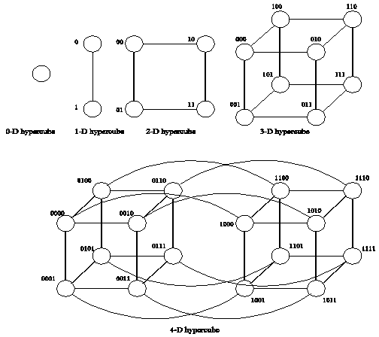
Interconnection Topologies
Hypercube

Slide 53
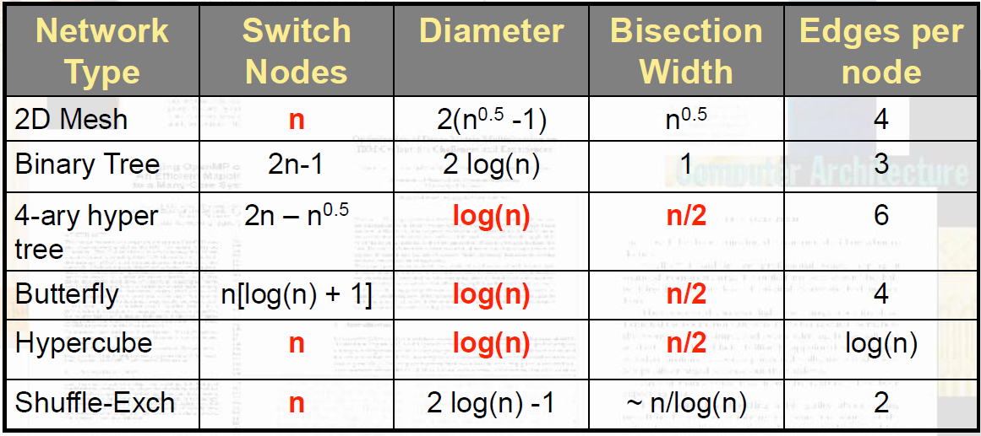
Interconnection Topologies

Slide 54
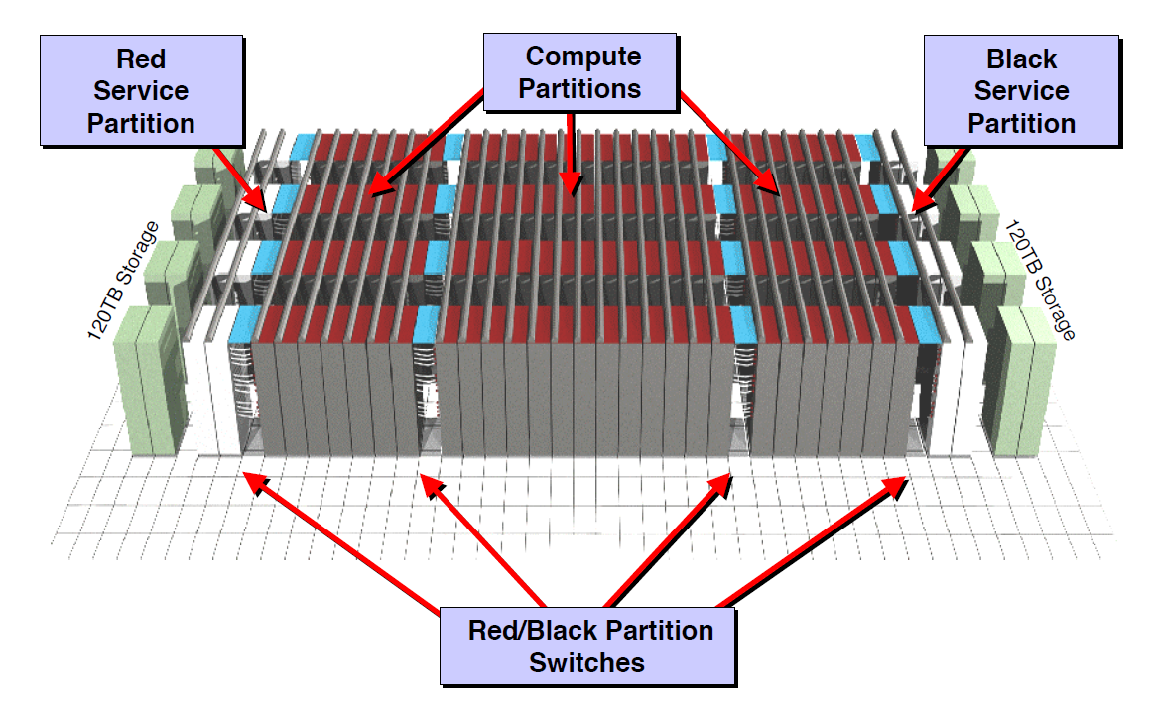
Red Storm – Cray Research (2003)
Notes:
Red Storm was a massively parallel supercomputer developed in the early 2000s by Sandia National Laboratories in collaboration with Cray. It was one of the first systems designed specifically to achieve terascale performance using a highly scalable architecture. It used a distributed memory model, where each processor had its own local memory, and processors communicated through message passing rather than shared variables. This allowed the system to scale to thousands of processors without the limitations of global memory access.
The interconnection network in Red Storm was based on a 3-dimensional mesh/torus topology, where processors were connected to their neighbors in multiple dimensions. This reduced communication distance and allowed for efficient data movement across the system. The system supported both compute nodes and service/I/O nodes, separating computation from input/output operations to improve overall efficiency and reliability.
Red Storm was designed with scalability and reliability in mind, allowing portions of the system to be reconfigured or maintained without bringing down the entire machine. From a programming perspective, Red Storm relied heavily on message passing models such as MPI, which required programmers to explicitly manage communication between processors.
The key takeaway is that Red Storm represents a practical implementation of large-scale parallelism, combining distributed memory, mesh-based interconnects, and message passing to achieve high performance at scale.

Slide 55
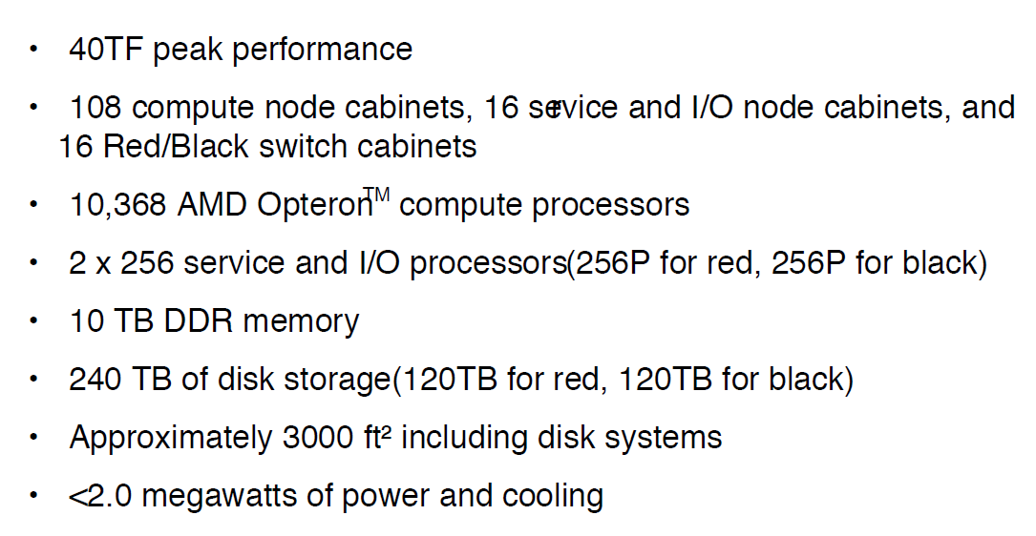
Red Storm Overview

Slide 56
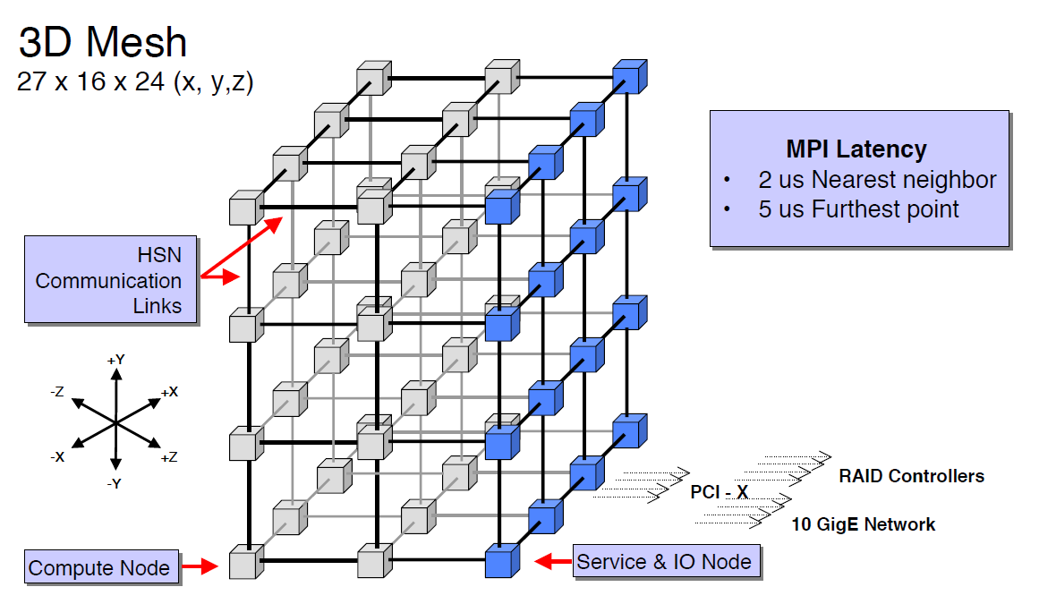
Red Storm Network
Notes:
The interconnection network in Red Storm is based on a three-dimensional mesh/torus topology, designed to support large-scale parallel communication with low latency and high scalability. In this network, each node is connected to its neighbors in three dimensions—commonly referred to as the X, Y, and Z directions. This means that each processor can communicate directly with multiple neighboring nodes, reducing the number of hops required to reach distant nodes.
The use of a torus structure means that the edges of the mesh wrap around, connecting opposite sides. This reduces the maximum distance between nodes and helps balance communication paths across the network. Communication is performed using message passing, where data is explicitly sent from one node to another. Messages are routed through the network, passing through intermediate nodes as needed. The routing is typically deterministic, meaning that paths are chosen based on node coordinates, which simplifies routing decisions and reduces overhead.
One of the key advantages of this design is its scalability. As more nodes are added, the network expands in three dimensions, keeping communication distances relatively low compared to simpler topologies like a 2D mesh. Additionally, the network is designed to handle high bandwidth and concurrency, allowing many messages to be in transit simultaneously without overwhelming a central communication point.
The Red Storm network uses a 3D torus to balance locality, scalability, and communication efficiency, making it well suited for large-scale scientific and engineering computations.

Slide 57
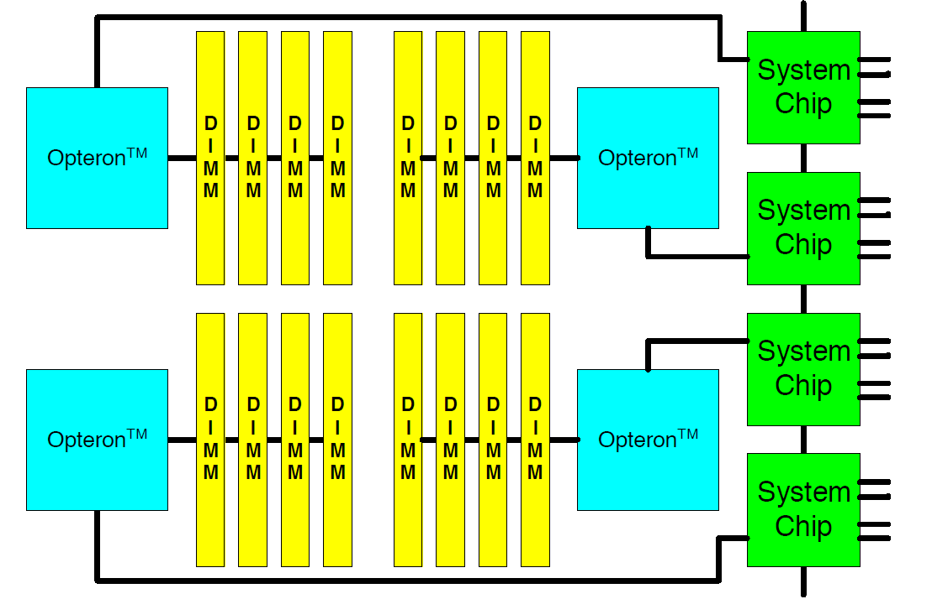
Red Storm Processor Board
Notes:
Depiction of organization of processor boards in Red Storm.

Slide 58
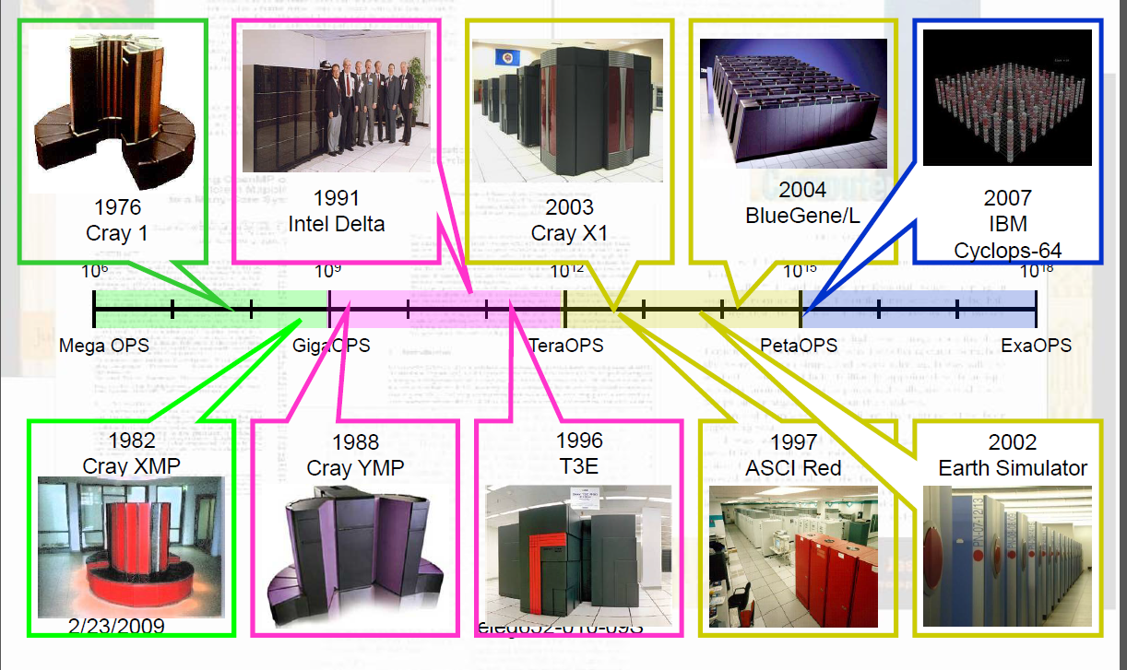
Growth Over Thirty Years – from 23 years ago
Notes:
The depicted years, while some time in the past, show the time frames in which the networks that we reviewed were developed. Now think about the current state of the art, the Cray 1 has been more than replaced by a computer you can hold in your hand. Cost and distances have decreased, pushing the concentration of information flow into smaller physical space. We are looking at the move toward ExaOps through the 2002 time frame, and interconnections along with variations in computer cpu and communications organization have occurred since. Going forward, ask questions about the modern examples of computer interconnects and how they may approach the problems differently.

Slide 59
What Have We learned Over 30 Years?
Building general-purpose parallel machines is a very difficult task.
Proof by contradiction:
  Many companies have gone bankrupt or left the parallel machine market
Even harder is developing general parallel programming schemes
  Still an art rather than a science

Slide 60
Additional Material

Slide 61
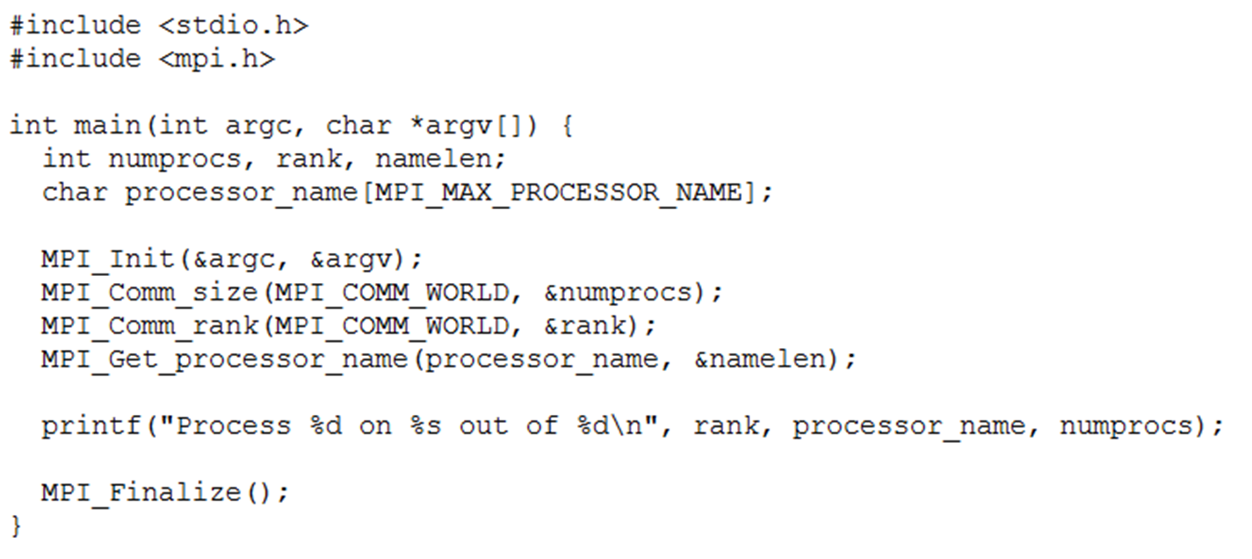
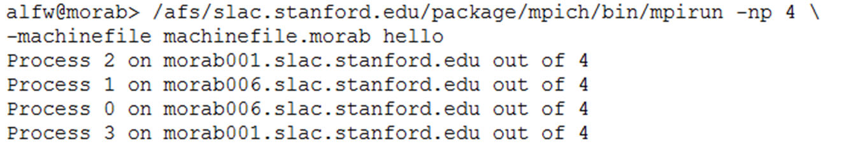
SIMD => Data Level Parallelism

